Slide 1
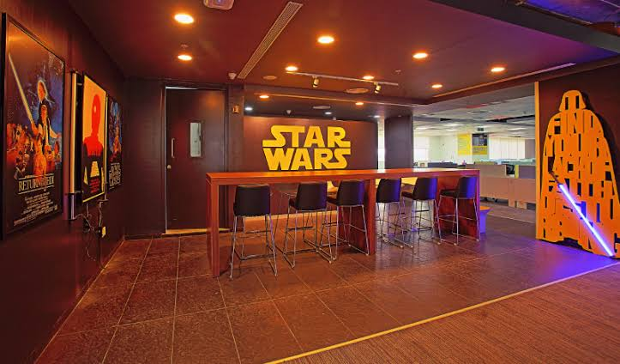

FLIPKART JEDI TRAINING
Notes:
Hi Everyone,
Good Morning
Before we start with the presentation today, I would like to share a small recital.
We have been a part of Publicis Sapient for almost 3months now, and there is this fact that everyone of us would agree upon.
We all started as fresh graduates, underwent 5weeks or so of rigorous training followed by what…5 weeks now of a Hands On project, and what has transpired in these days is a fact that we all are really proud of. A transformation from someone who could code, to someone who can not only code, but add value to everything he does.
So have we succeeded at becoming a Product engineer?
Hi, I am Rajat, a small part of our big team here.
I am here with my colleagues Aman and Chinmay and we are here to give you a walkthrough of our Transformation, our Journey and the project we have been working for sometime now.

Slide 2






JEDI TRAINING
13 days
312 hours
18,720 minutes
11,23,200 seconds
ENRICHING LEARNING
EXPERIENCE

Slide 3

Agenda
Problem Statement
Development Process
Agile development
UML Artifacts
Tech stack
POS Application
Rest APIs
Dropwizard
Demo
Challenges & Learnings
Questions

Slide 4
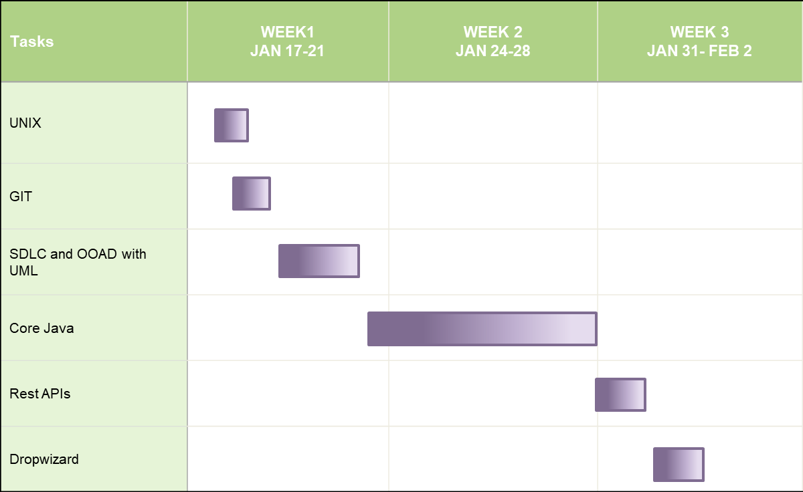
TRAINING FRAMEWORK

Slide 5
PROBLEM STATEMENT
Create a Course Registration System using AVA/REST tools and technologies, where professors and students can enroll in courses and are able to perform standard course registration processes specific to their respective use cases.

Slide 6
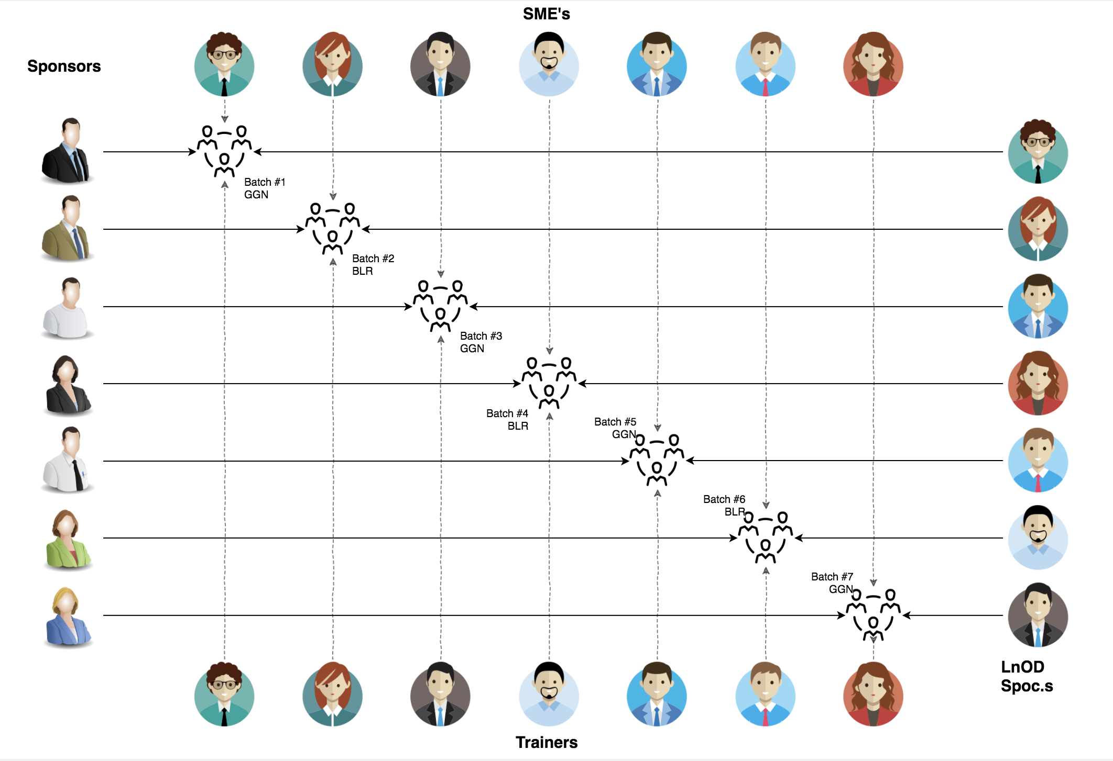
Stakeholders
Sponsors:
Flipkart
SME’s
1. Amit Balyan
Coordinators
Deepika
Shree Lakshmi

Slide 7
Process

Slide 8
Requirement Gathering and Analysis
UML artifacts designing
Identify use-case [USE-CASE diagram]
Identify classes and method [CLASS diagram]
Identify the activities according to roles [Activity Diagram]
Identify the flow of methods [Sequence Diagram]
Senior review of all UML Diagrams
Selected the tech stack and tools
Prepared console based application with array Implementation.
Learned the use of collection and used for the same.
Converted the console based app in to Rest Api based and tested with postman.
Finally shifted the application into dropwizard.

Slide 9
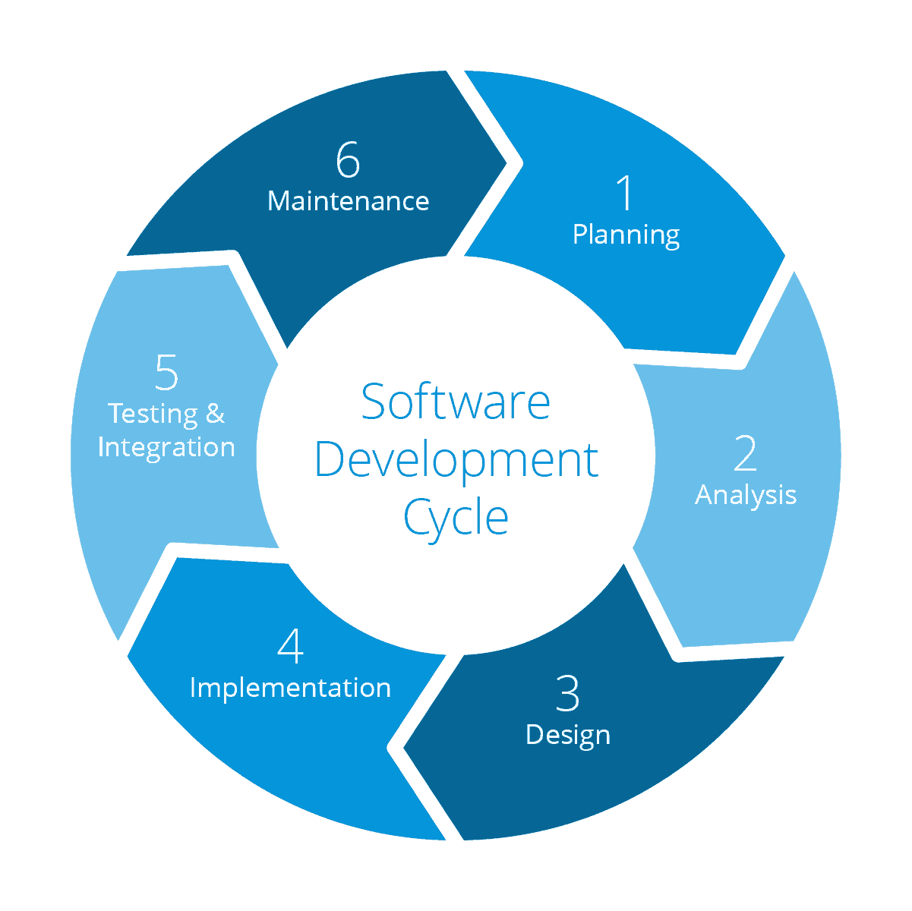
SDLC - Agile development process
Scope: for Universities
Stakeholders:
University
Student
Professor
Administrator
Deployment platform: localhost
Problem:
Course Registration System
Solution:
POS application
REST based application
Platform:
Window, mac, linux
Manual Unit Testing
and Manual Integration Testing
Development Platform: Window, Mac, Linux
IDE: Eclipse
DB: MySQL
Tools:Postman
UML artifacts:
Use-case Diagram
Activity Diagram
Sequence Diagram
Class Diagram

Slide 10
Daily Meeting
Task Assignment
Requirement understanding
Research and analysis
Estimation
Sprint Planning
Spring Grooming
Delivery
Sprint Implementation
Development
Code Review
Commit
Integrate
Deploy
Test
Notes:
Time – 1 min

Slide 11
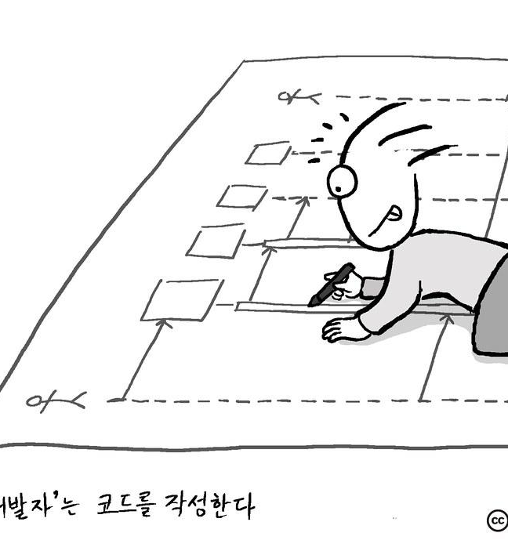
UML Artifacts
An artifact in the Unified Modeling Language (UML) is the specification of a physical piece of information that is used during a software development process.
Project requirements were mapped into UML artifacts to visualize how the CRS system had to be designed.
Following diagrams were designed for CRS system:
Use case diagram - To identify the use case.
Class diagram - To identify the classes, their properties and methods and relationships among each other.
Activity diagram - To identify the activities according to user roles.
Sequence diagram - To identify the flow among different methods.

Slide 12
Tech Stack

Slide 13








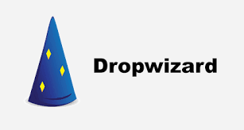

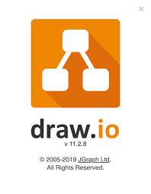

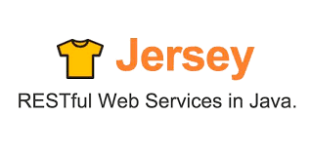





Tools
and
Technologies
Documentation
Core Language
SQL Database
Collaboration
Learning
Framework
IDE
SCM
Designing
Framework
Project Management
Task Keeping and Notes
Application Server
Logger
Verification
Notes:
Time – 1 min

Slide 14
POS - Console Based Application

Slide 15



POS Application
Java Client
Business Logic
Database Code
HTTP
Request
HTTP Response

Slide 16

Console Based application run on console of ide which gives us messages with print statement and takes input from user based on requirement and then display the desired result.
In this we gradually designed our application based on problem statement and then connect it to local database. In our case we have used MYSQL.
For logging Log4j library has been used to keep record of information and error.
Following is the POS project structure:
Application: Main class and menu of the each role.
Beans: All the attributes of class table in database and their getter and setter methods.
Business: Defined logics and functionality need to perform based on user input.
Constants: Defined the value of some variables which we are using frequently like sql queries.
Dao: Present logics for performing sql operations called by services
Exceptions: User defined exceptions classes are present here.
Utils: For structures and connectivity classes.

Slide 17
RESTfulAPIs and DROPWIZARD

Slide 18
REST APIs
REST stands for REpresentational State Transfer. It means when a RESTful API is called, the server will transfer to the client a representation of the state of the requested resource.
A RESTful API follows the REST architectural constraints. These development constraints allow for faster, scalable APIs that support all data types. RESTful APIs are fast, flexible, scalable, and versatile.
At this stage of project development, the POS application was converted into RESTful APIs which ran on Tomcat 8.5 server and were tested using POSTMAN.
We used JAX-RS API - a Java programming language API designed to make it easy to develop applications that use the REST architecture. We used Jersey to implement JAX-RS. Jersey is RESTful Web Services framework for developing RESTful Web Services in Java that provides support for JAX-RS APIs.

Slide 19

Dropwizard
Dropwizard is a Java framework for developing ops-friendly, high-performance, RESTful web services.
Dropwizard = Jetty for HTTP + Jersey for REST + Jackson for JSON
We converted Jersey REST Apis into Dropwizard Apis and ran APIs on server provided by Dropwizard.

Slide 20

Demo
Notes:
Time –
POS- Student -5 min
REST - Professor - 3 min
DropWizard- 3 min

Slide 21
Challenges Faced

Slide 22

Environment setup where we required to integrate different technologies to work together.
While working on rest API through postman sql connector version problem was faced which was solved later on.
Working online and merging logics from different system was time consuming.

Slide 23

Our Team
Notes:
Time – 2 mins

Slide 24
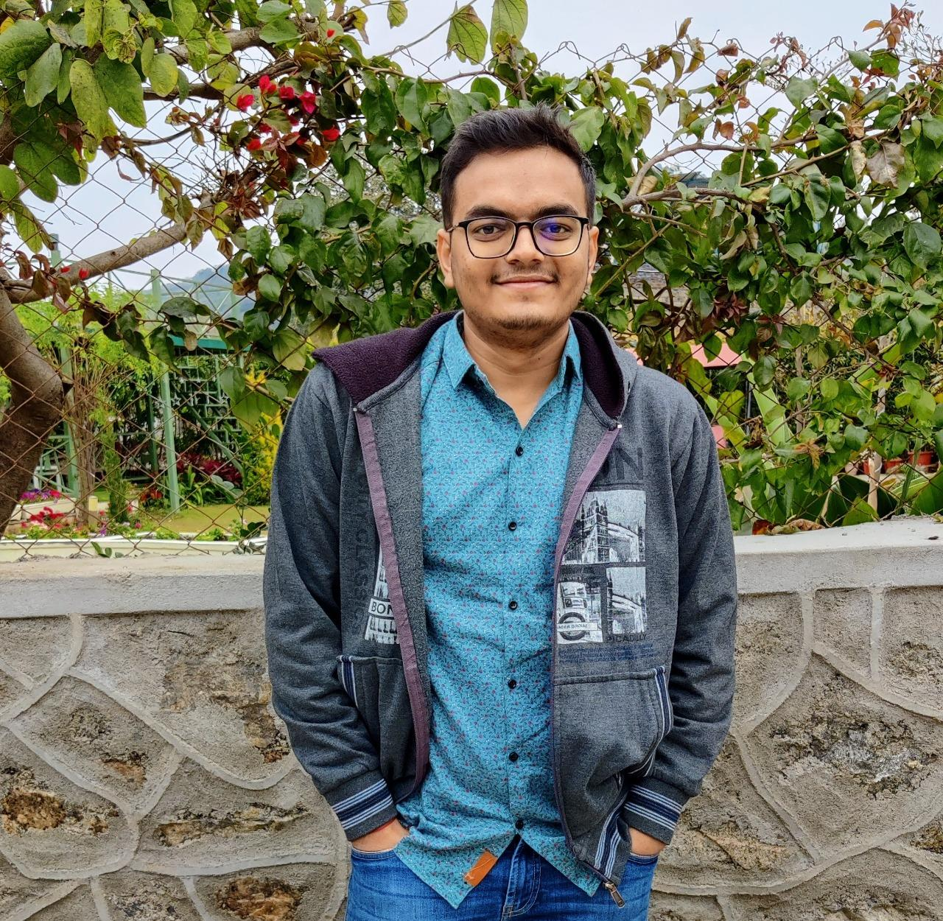
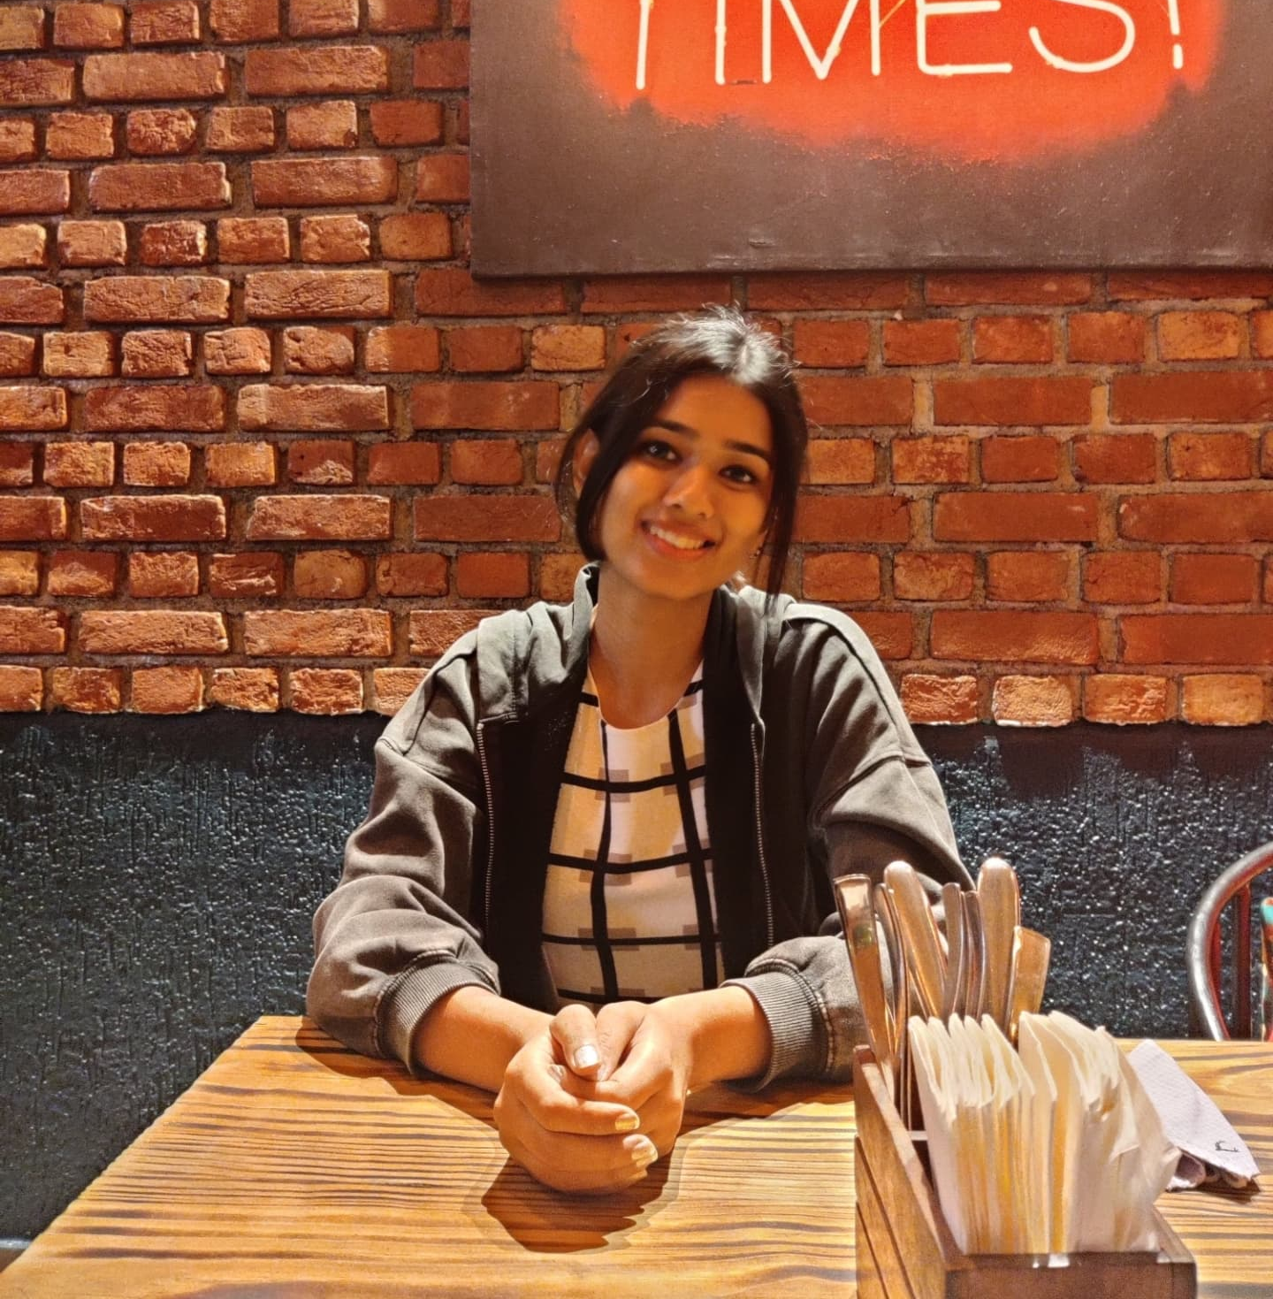
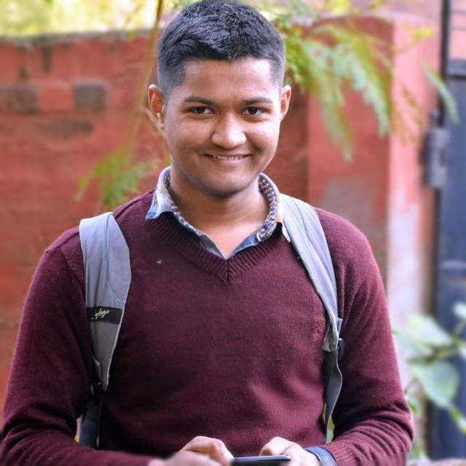

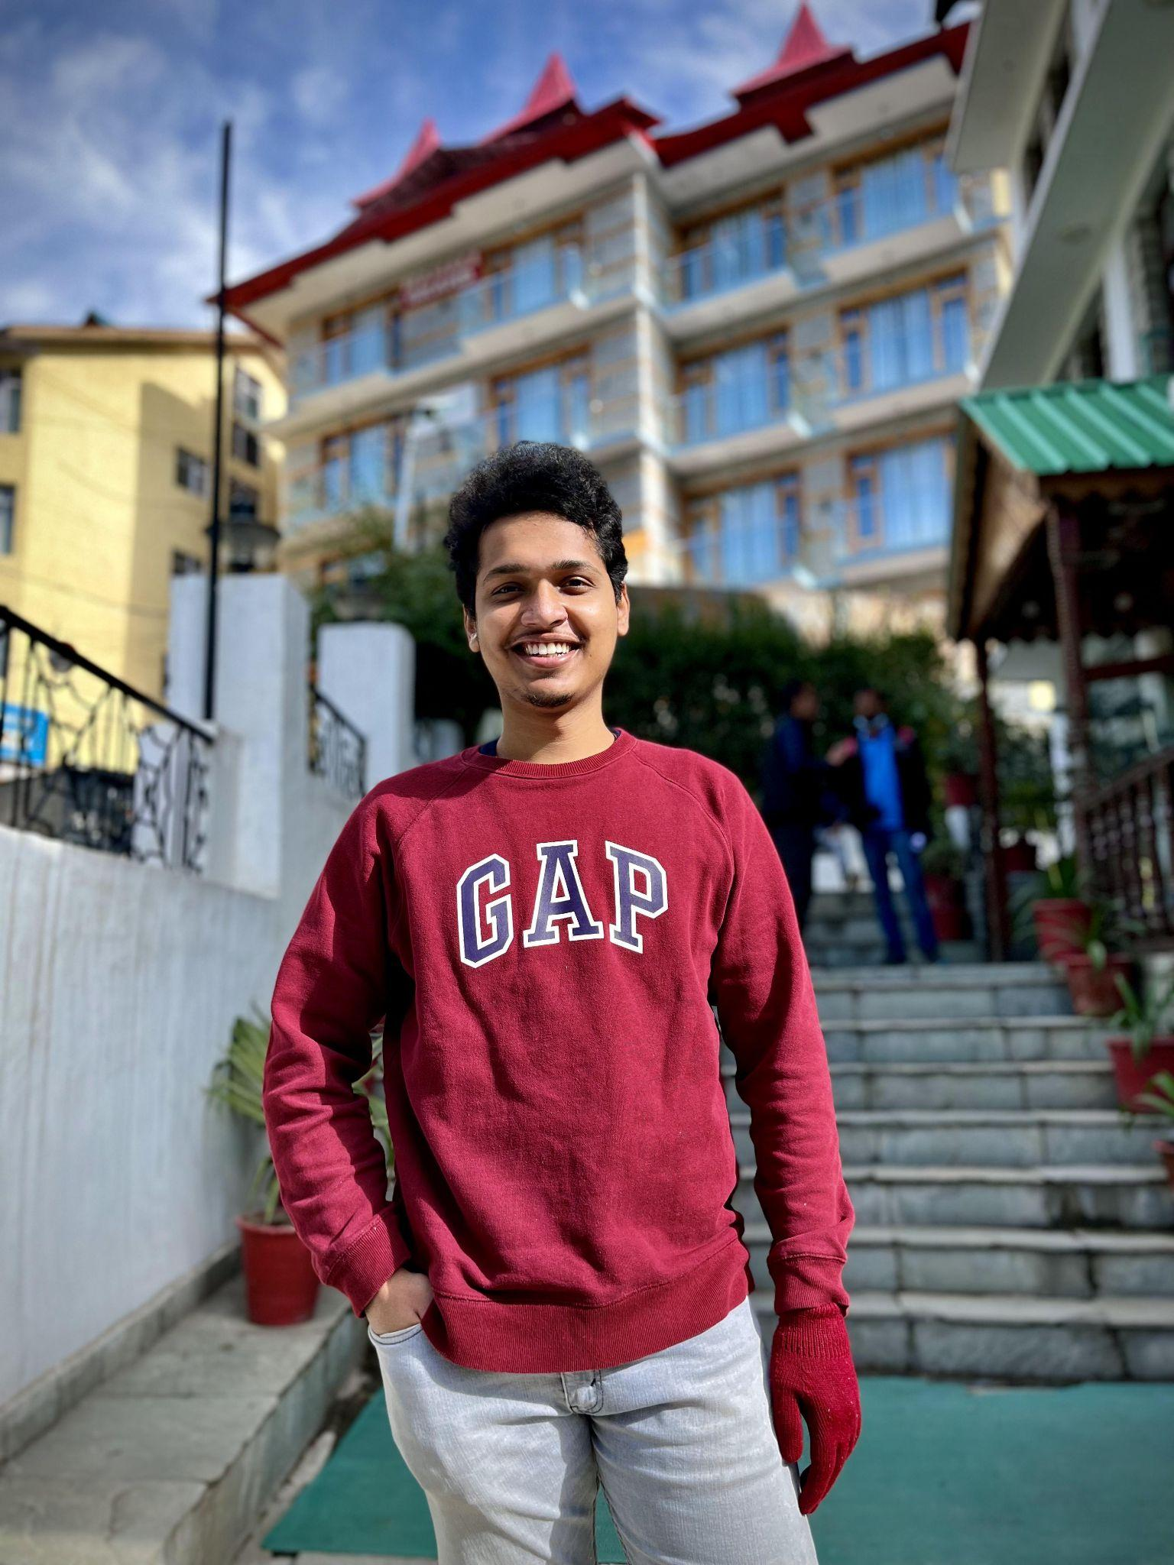
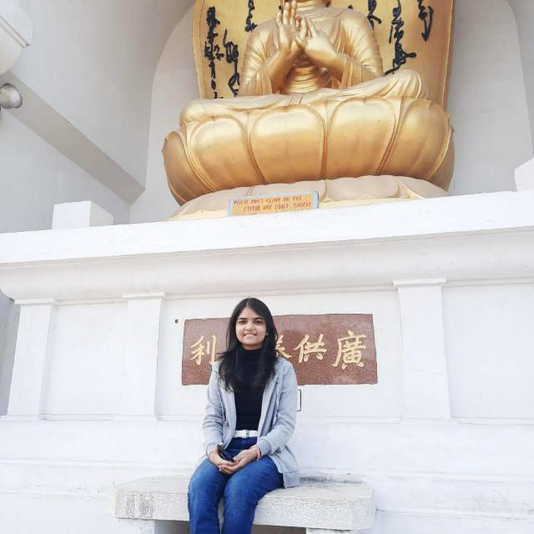
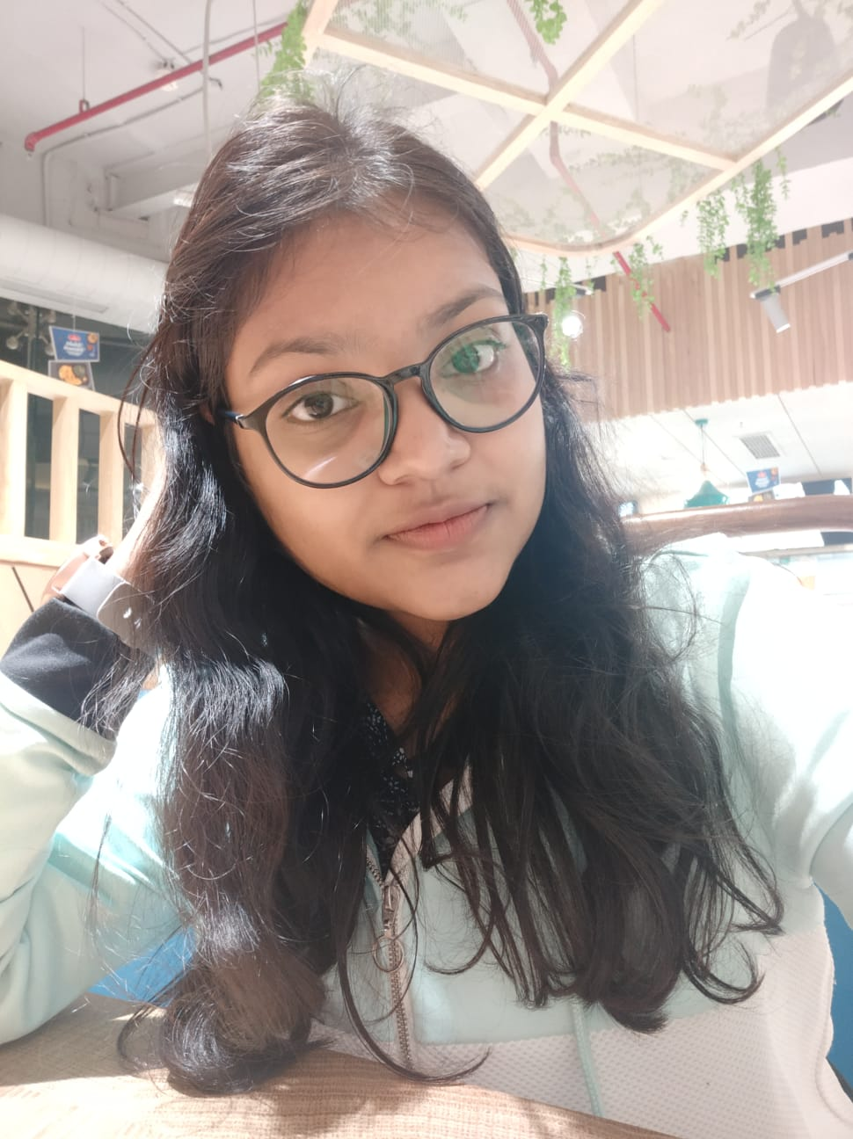

Savan Matariya
Vrinda Agarwal
Parth Patel
Nikhil Kumar
S.V.S.Sudheep Rao
Nandini Roy
Shruti Bansal
Aadarsh Jain

Slide 25

Questions
Notes:
Time - ?

Slide 26

Thank you

